Slide 1
7330 Twitter data project
Chris Morgan & Eduardo Cantu

Slide 2
Purpose
Twitter has wealth of data that can be used for various forms of analysis but it can be a bit daunting to tackle
We will be discussing how to develop a twitter streaming script and pull the data into a database (MongoDB)
Specifically, we have an interest in examining how much attention is being generated related to the T-Mobile & Sprint merger

Slide 3

Getting the data
One of the most commonly used ways to access twitter data is through the package Tweepy, a python based API for accessing twitter data
To gain access, a developer account has to be set up and a purpose of how the data will be used is required by twitter through an application process
Approval for student projects seems to go much quicker when used for limited purposes
This can be done at https://developer.twitter.com

Slide 4

Why mongo
Twitter data could best be described as “structured unstructured” data
We know things like mentions, hashtags, and general formats that can be used, but we really don’t what will and will not be included for each tweet
Given that we would like the ability to efficiently store cases where there may be no hashtag data or a lot, a NoSql solution with MongoDB makes sense.
This allows for much more flexibility in data that is captured and is actually easier to develop for.
Did examine pushing data into a MySql Solution, but this presents limited flexibility and many compromises since the developer would need to

Slide 5
Streaming vs batching vs historical
Streaming allows for the intake of twitter data in real time
This allows for broader searches where a user can take in data by text, hashtags, etc
Allows the ability to quickly get a pulse for activity
Batching twitter data often involves pulling historical data from defined users
Often this is referring to enterprise grade licensing, but can also refer to user data pulled in a batch.
This somewhat limits the scope since getting historical hashtag data is nearly impossible
Enterprise grade batch/History data
Can be purchased through an enterprise license, not available freely without restrictions
Will not be in scope as it is only available on contractual basis for a cost.

Slide 6
Performance - streaming
Streaming requires the program to be active, which does greatly limit practicality in events of a crash
Being limited by program uptime also greatly limits the amount of data that can be collected in reasonable periods of time
There is a rate limiter in place for tweet streaming so some data may be missed
30 requests/min or 10 requests/sec

Slide 7
Performance – Batch/User Based
Batch based analysis can be done pull historical data from 1 or more users
This does allow for deeper dives into targeted historical data
This does greatly limit our ability to sample the population however

Slide 8
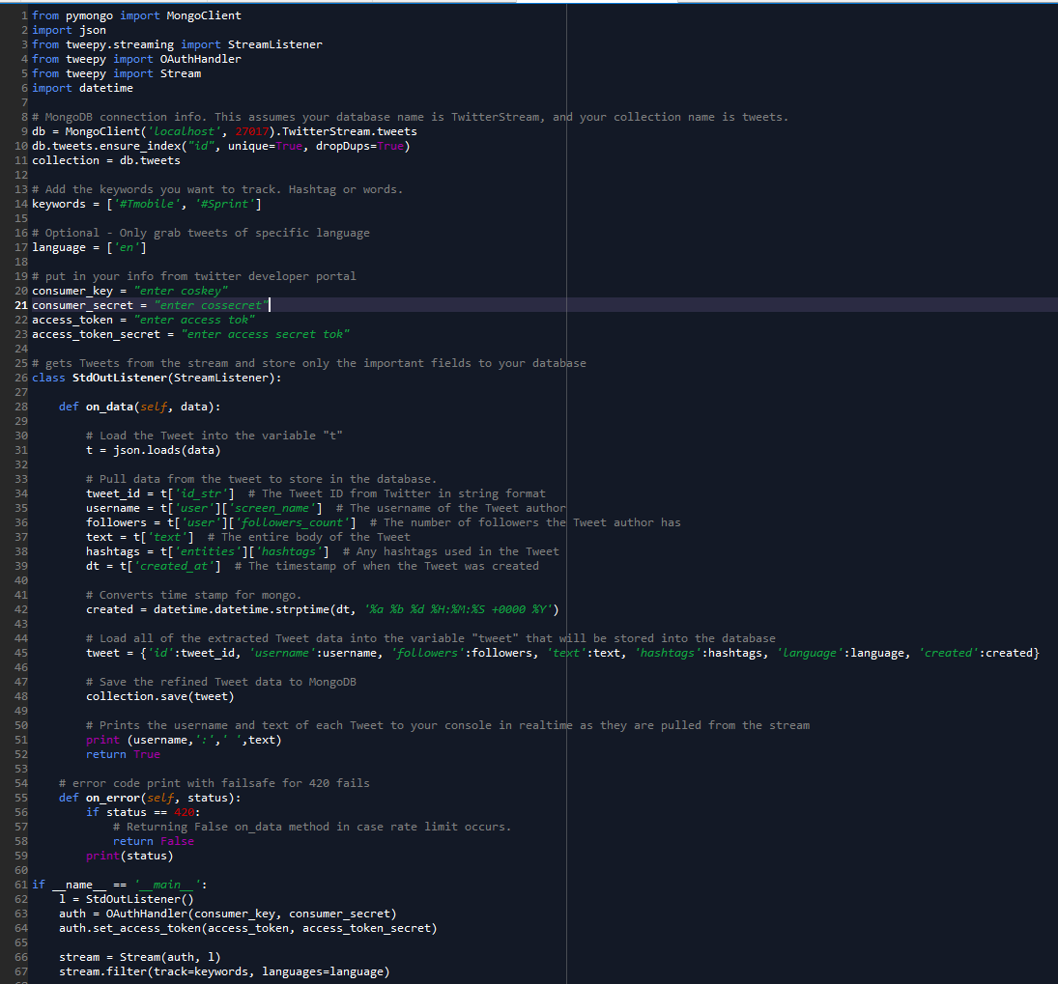
How the code works
Mongo Setup
Search material
Twitter access data
Pulls the tweet JSON data and assigns it
Turns data into single unit and saves to mongo
Prints tweet in real time
420 error code to prevent being booted
Works of body of the code

Slide 9
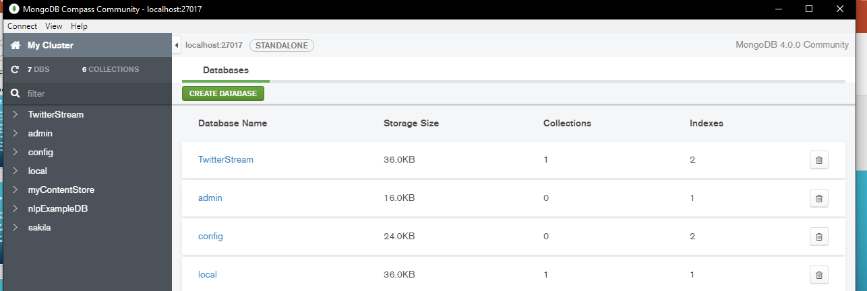
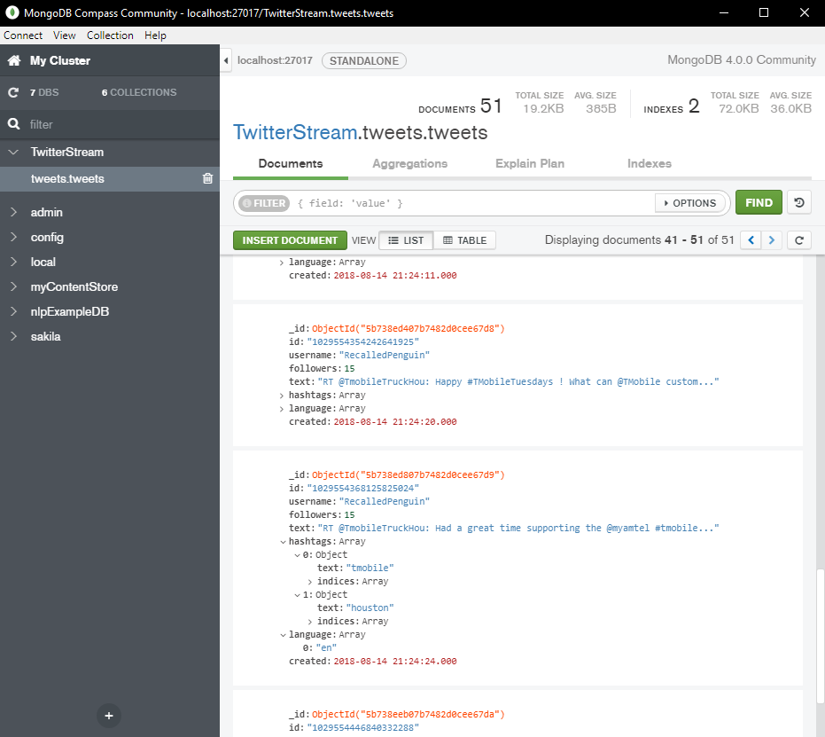
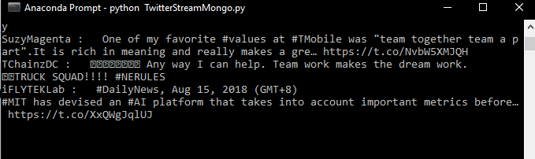
Running the script
Setup MongoDB database first…
Start MongoDB
End the program after sometime and refresh MongoDB to ensure the data transfered

Slide 10


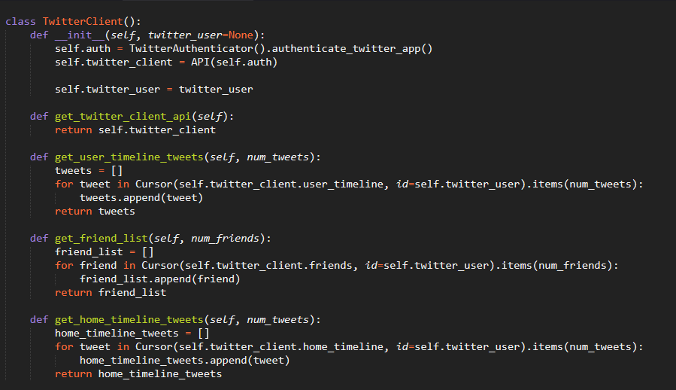
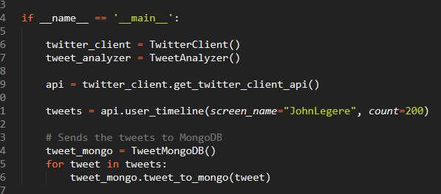
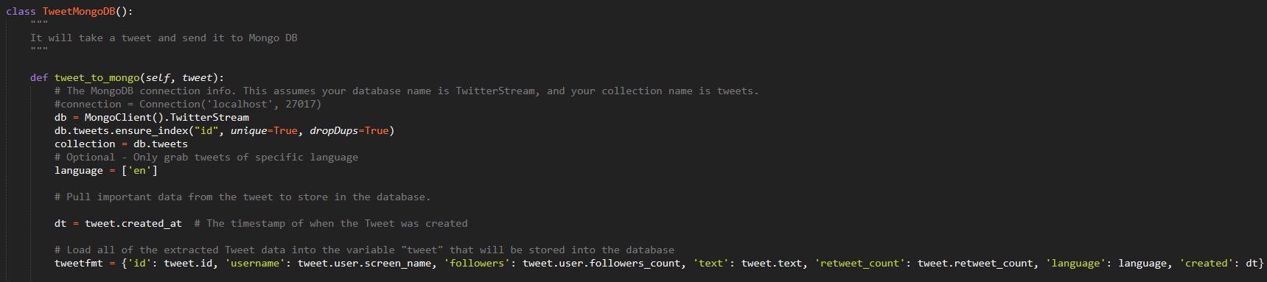
Filtering tweets by User and timeline
Sets the class to filter the User and the number of Tweets
It will create the objects and send the User Tweets into MongoDB
Sets the class to connect to MongoDB and insert tweets

Slide 11
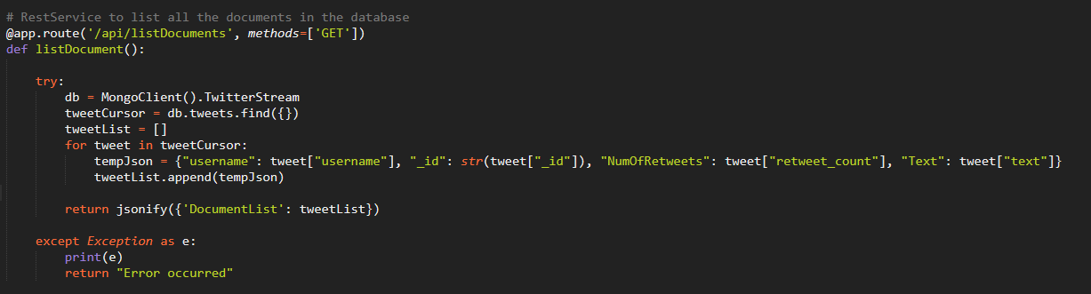
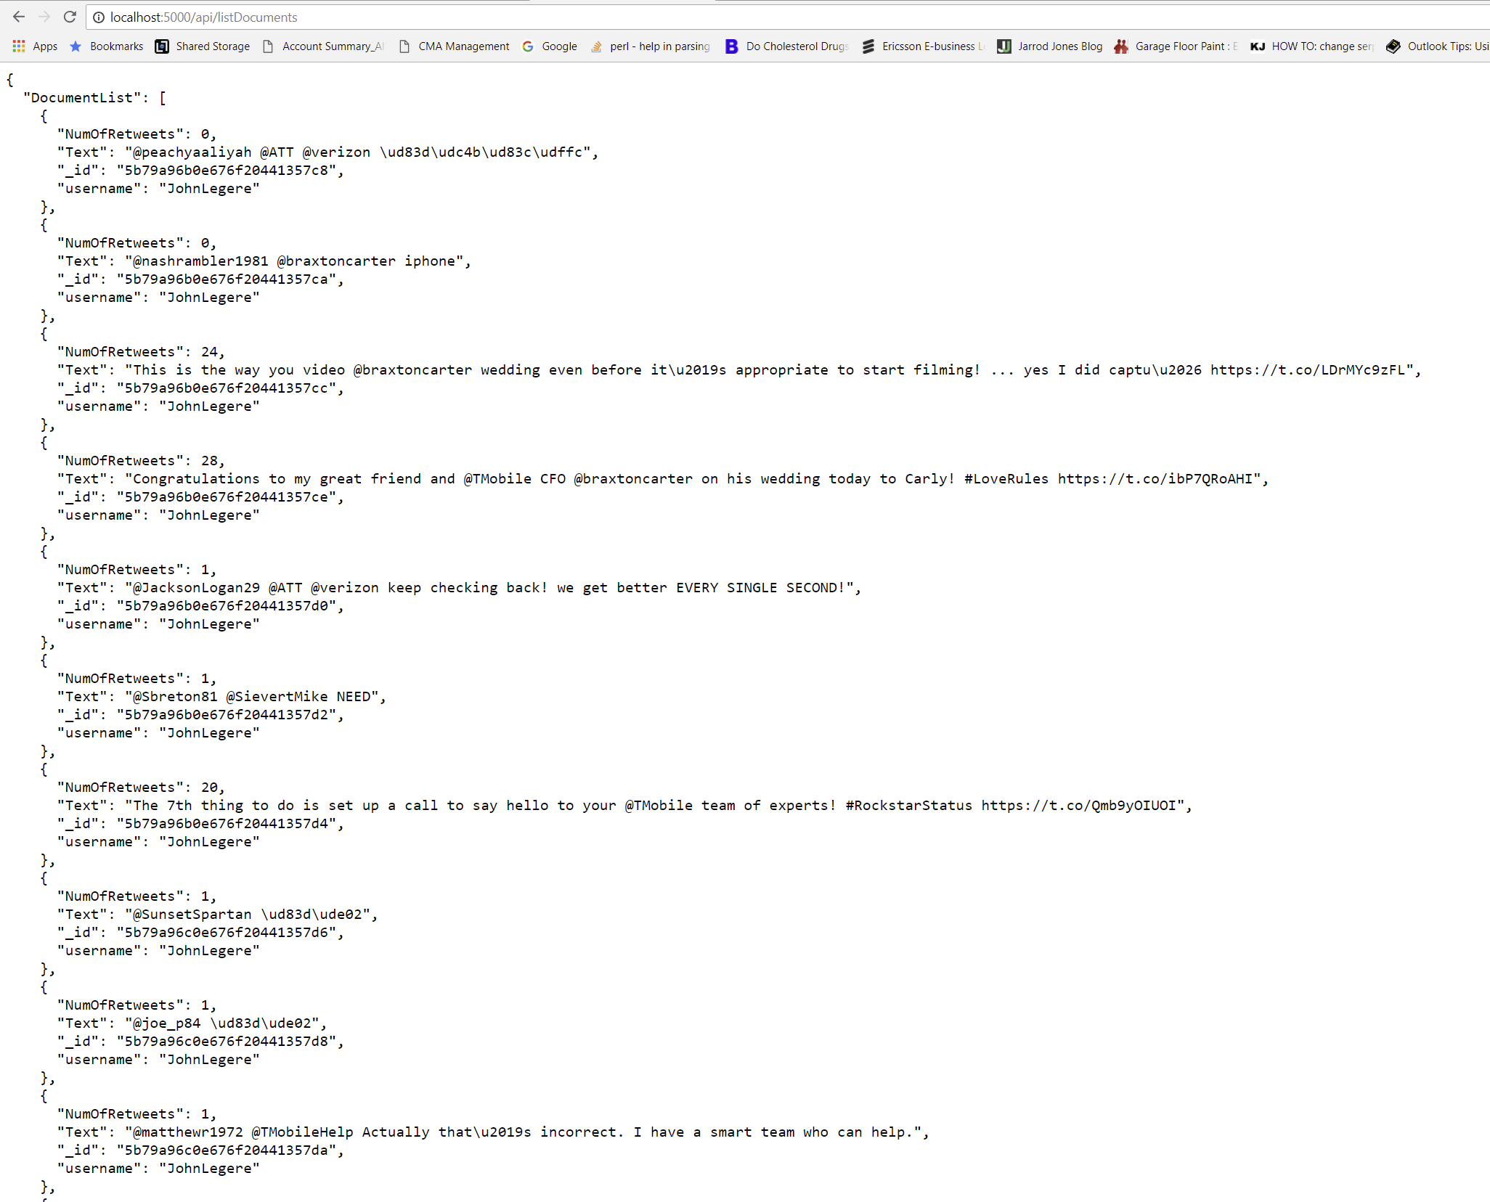
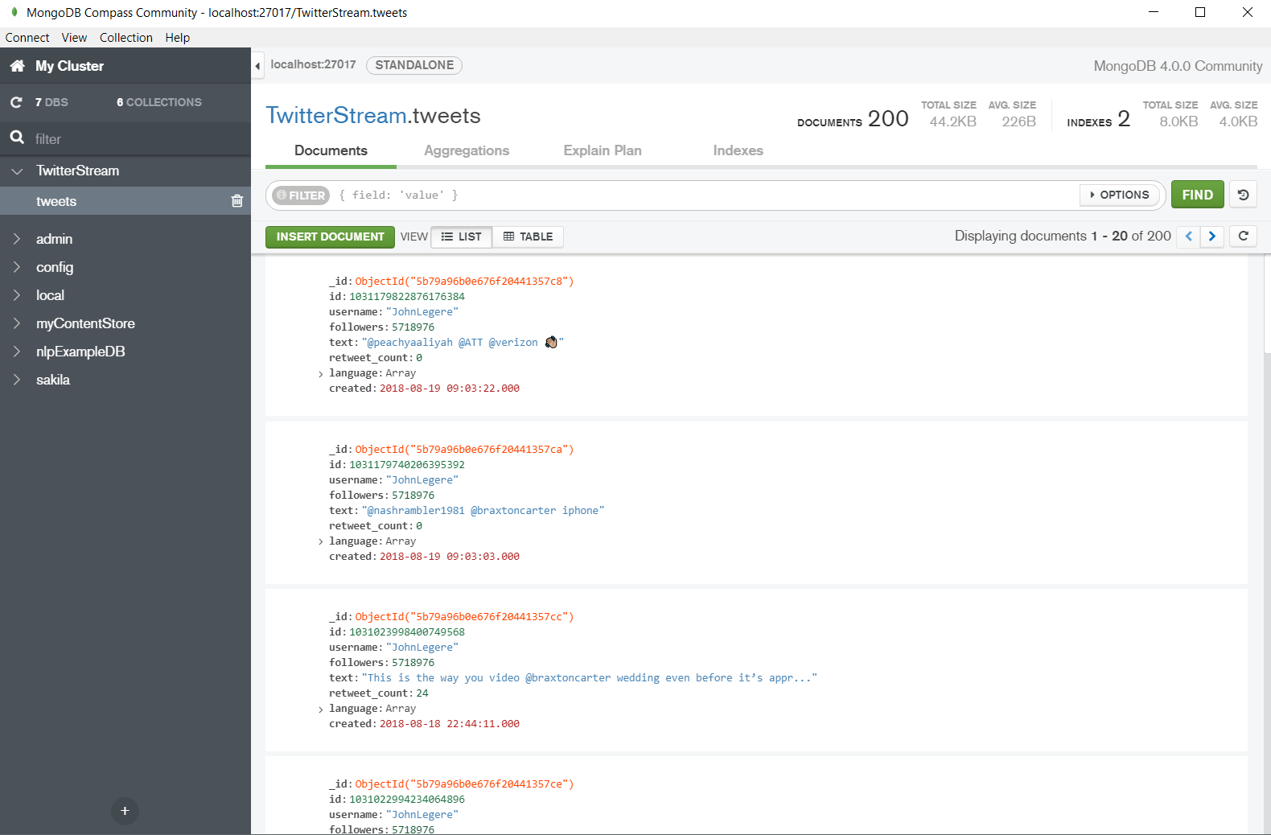
Running the Script
Using a REST service to display all the 200 tweets
200 Tweets into MongoDB from user John Legere

Slide 12
Results
Data successfully pulled into MongoDB locations for streaming
From our sampling, we didn’t find one reference to our initial goal of merge content
This may be an indicator that this topic may not be drawing a lot of public attention currently

